Slide 1

FRAUD DETECTION - ASSIGNMENT
Build trust in digital communications by detecting fraudulent scraping activities
Submitted By:
SARTHAK DARGAN
+91 9810437497 | sarthak221995@gmail.com
Submitted On:
30th June 2025

Slide 2
EXECUTIVE SUMMARY
Critical Threat Identified: 841 High-Risk Fraudulent Users Detected
Situation: Analysis of 26,000 users revealed systematic data scraping operations targeting Truecaller contact database, with fraudulent users exhibiting extreme behavioral patterns that clearly distinguish them from legitimate platform usage.
Key Findings:
Confirmed Fraud Detection:
841 critical fraudulent users confirmed through dual-model detection (3.2% of analyzed population)
1,759 total anomalous users identified requiring immediate review (6.8% of user base)
Both models agreed on high-risk cases, providing strong confidence in fraud identification
Behavioral Evidence:
Fraudulent users perform 7.3x more searches (202.3 vs 27.7 average searches)
25x higher search-to-communication ratios (53.22 vs 2.13 for normal users)
6x higher activity concentration (63.4 vs 10.5) indicating burst, automated behavior
Immediate activity pattern present in 77.2% of fraudulent users vs only 6% of normal users
Impact Quantification:
Fraudulent users consume disproportionate resources with 202 searches vs 28 for normal users
Clear automation signatures including near-zero intervals between searches (0-1 seconds)
First search activity begins 3x faster (0.8 days vs 2.4+ days for legitimate users)

Slide 3
PROBLEM STATEMENT
The Trust Crisis: How Fraudulent Scrapers Threaten Truecaller Core Mission
A simple Google search reveals numerous "Truecaller scraper" tools actively targeting the platform, creating cascading business impacts
Revenue & Infrastructure Impact:
API Revenue Loss: Fraudulent usage without legitimate subscription payments
Infrastructure Strain: Bot traffic increases server costs and degrades performance
Compliance Risk: Privacy violations expose platform to regulatory penalties
Strategic Threats:
User Trust Erosion: Privacy violations directly undermine our core value proposition
Data Quality Degradation: Scraped data potentially corrupts spam detection models
Platform Abuse: Legitimate user experience suffers from infrastructure strain
Each fraudulent user performs 202 searches monthly compared to 28 for normal users, creating disproportionate system load while providing zero legitimate platform value.

Slide 4
FRAUDULENT USER PERSONA
5 Digital Fingerprints: How We Identify Fraudulent Scrapers
The Fraudulent User: Someone who exploits legitimate signup processes to systematically harvest contact data through high-volume, automated activity patterns that deviate dramatically from genuine user behavior.
5 Threat Profiles:
1. The Data Harvester (High Search Activity) - Disproportionately high search volume vs. communication activity
2. The Speed Demon (Immediate Activity) - Heavy platform usage immediately after account creation
3. The Burst Collector (High Activity Concentration) - Intense activity bursts in short time periods
4. The Volume King (Unusual Activity Rates) - Daily activity volumes far exceeding typical user behavior
5. The Robot (Irregular Time Intervals) - Perfectly timed or extremely rapid intervals between actions

Slide 5
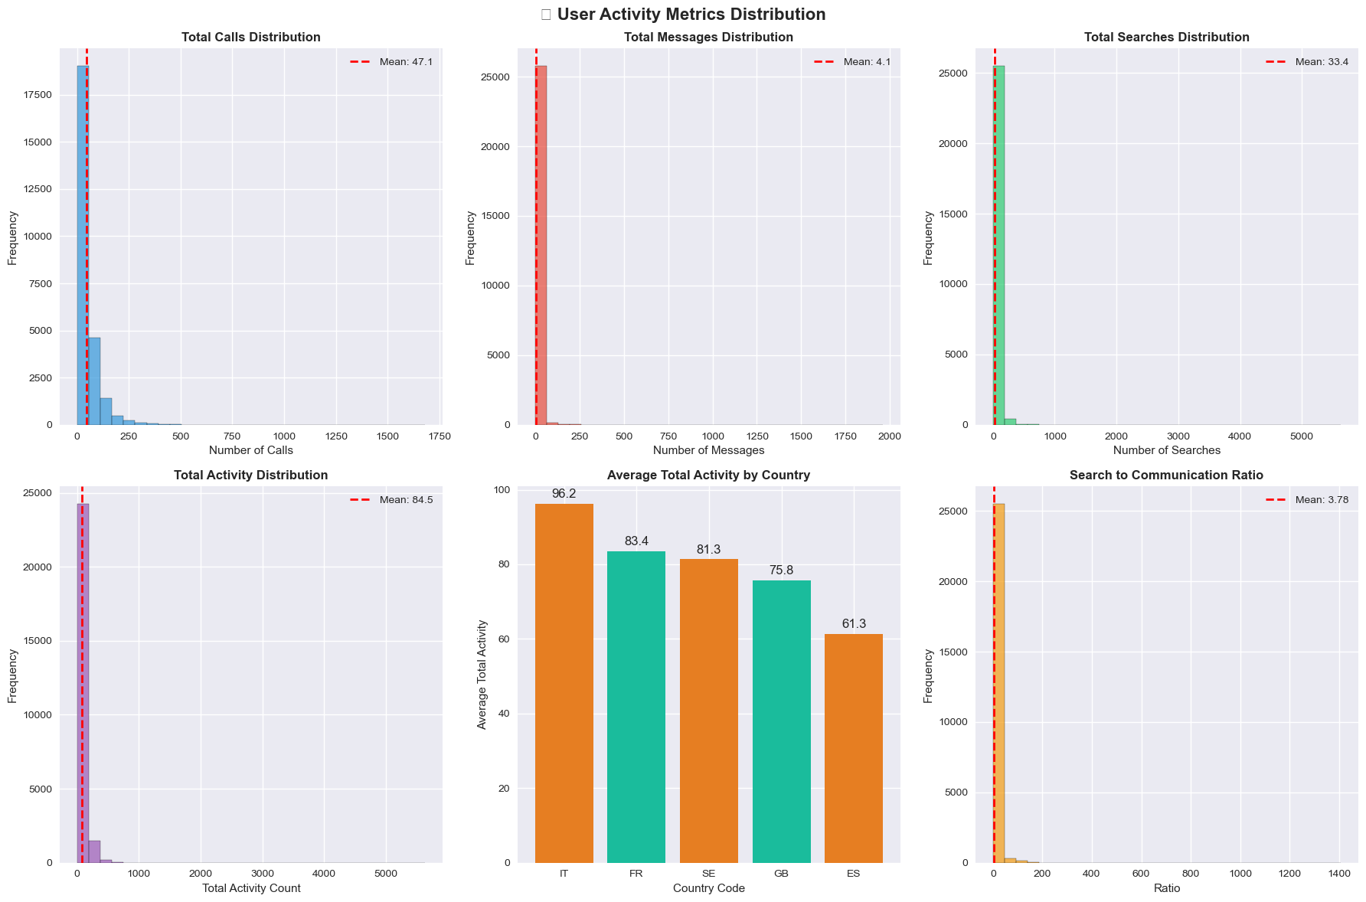
ACTIVITY INSIGHTS
The Smoking Gun: Search Behavior Reveals True Intent
The most users engage in limited calls, messages, and searches, while a few demonstrate very high activity.
The Search to Communication Ratio emerges as a powerful indicator. Users exhibiting a high search to communication ratio, performing numerous searches with minimal calls or messages, strongly suggest their intent is data harvesting, not genuine communication, directly pointing to potential fraudulent scrapers.

Slide 6
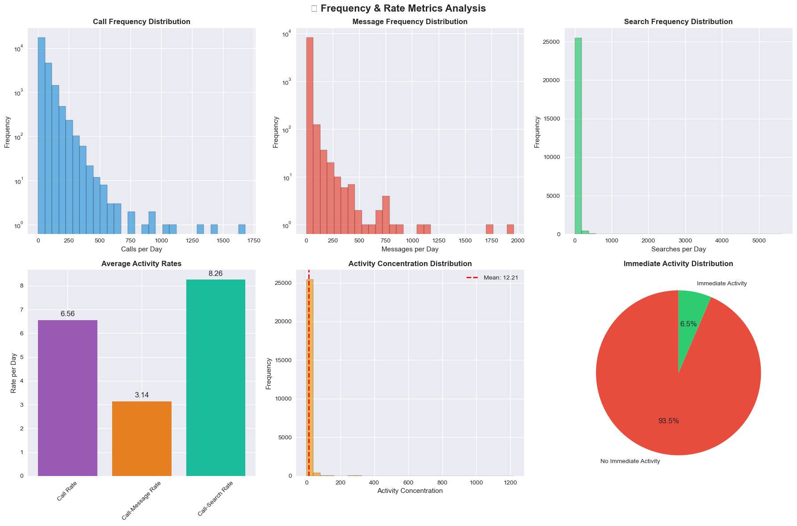
BEHAVIORAL TIMING INSIGHTS
Speed Reveals Intent: Timing Patterns Expose Automated Attacks
While most users exhibit low daily call, message, and search volumes, the logarithmic scales reveal a small subset with extremely high activity, indicating potential anomalies.
Critically, "Immediate Activity" is present in only 6.5% of users, making it a strong indicator of automated, non-human behavior characteristic of scrapers.
These insights into extreme outliers and immediate, automated patterns are vital for flagging fraudulent user IDs interested in harvesting data.

Slide 7
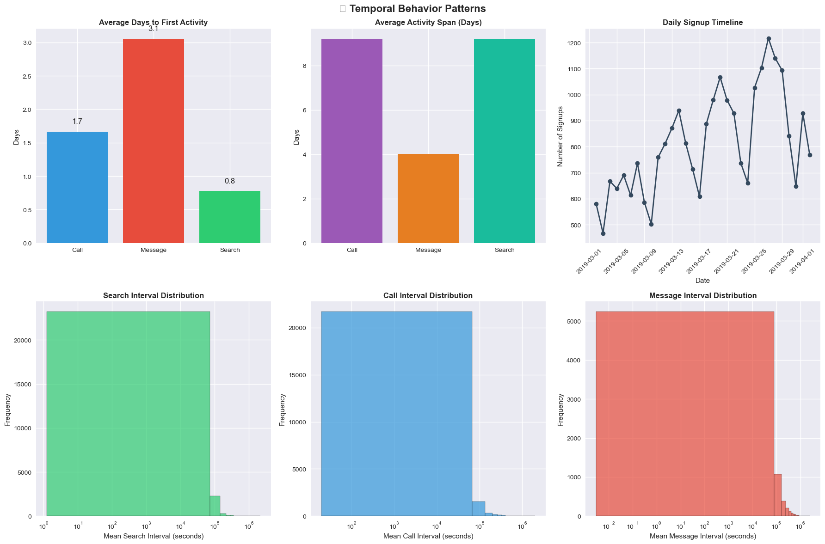
BEHAVIORAL TEMPORAL INSIGHTS
The 4 Key Data Events - User Signup/Calls/Messages/Searches
Users tend to perform their first search significantly faster (within 0.8 days) compared to initiating calls or messages (which typically occur after 1.7–3.0 days), indicating an immediate intent to extract information. Notably, extremely short average intervals between searches (as low as 0–1 seconds) strongly point to automated, bot-driven behavior. Furthermore, abrupt surges in daily signups may indicate coordinated account creation efforts. These temporal signals are key indicators of users involved in systematic data scraping.

Slide 8
DETECTION MODEL
Dual-Engine Defense: Isolation Forest + Autoencoder = Comprehensive Detection
Combat fraud through complementary detection approaches that identify both obvious outliers and subtle pattern deviations.
Engine 1: Isolation Forest (Classical ML)
Purpose: Rapidly identify users with extreme behavioral deviations Strengths:
Fast processing for large datasets
Highly interpretable results for business teams
Effective for high-dimensional tabular data Detection Focus: Volume-based anomalies, extreme ratios, clear outliers
Engine 2: Autoencoder Neural Network (Deep Learning)
Purpose: Learn normal user behavior patterns to detect sophisticated deviations Strengths:
Captures complex, non-linear relationships
Flexible for high-dimensional data patterns
Identifies subtle behavioral inconsistencies Detection Focus: Complex pattern deviations that traditional models miss

Slide 9
DETECTION RESULTS
Mission Accomplished: Clear Fraud Patterns Identified and Quantified
Fraudulent Users Report: # Critical Fraudulent Users - Detected by both Models: 841 (Fraudulent Rate: 3.2%) # Fraudulent Users - Detected by either of the model : 1,759 (Anomaly Rate: 6.8%) # Normal Users: 24,241
Refer to the Excel Sheet: Google Sheets
Normal User Tabs
Critical Fraudulent Users Tab
Fraudulent Users Tab

Slide 10
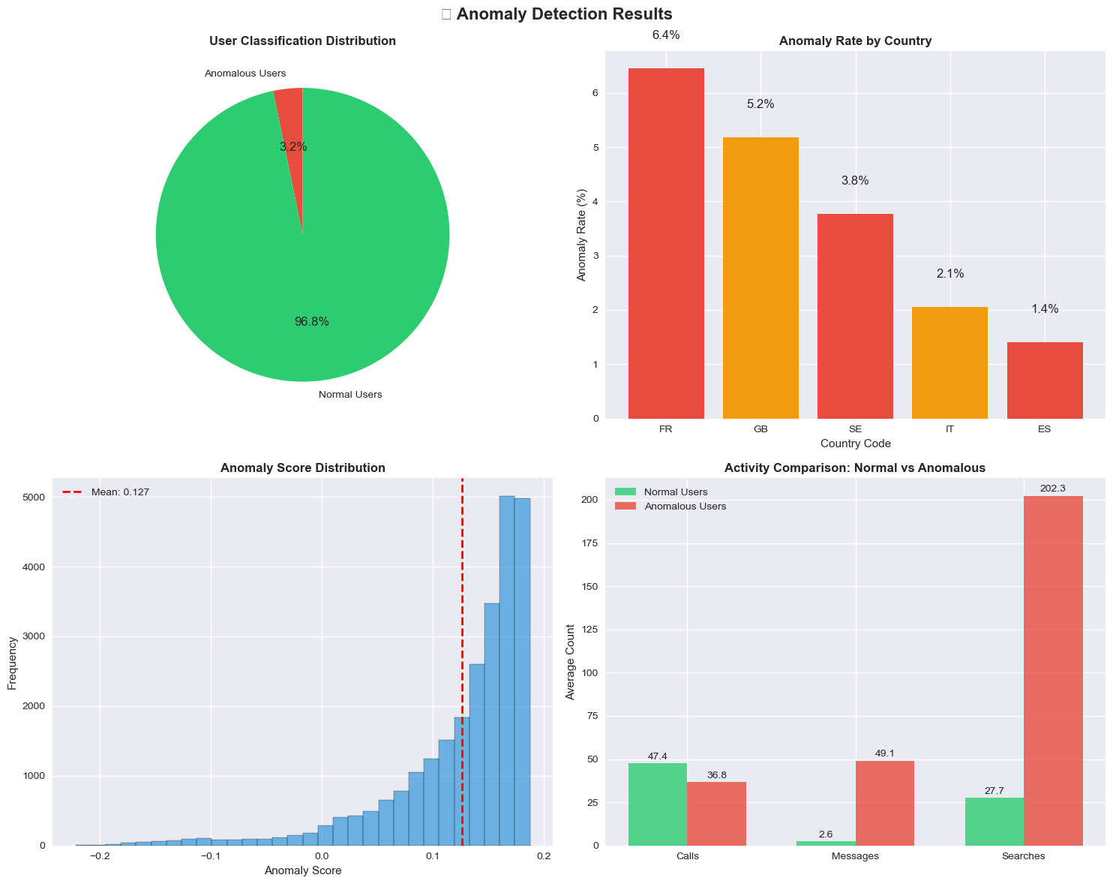
Critical Fraudulent User Insights
High-Confidence Threats: 841 Users Confirmed as Active Scrapers
Comparative Analysis:
Normal Users (25,159): Avg Searches: 27.7 Avg Search-to-Comm Ratio: 2.13 Avg Activity Concentration: 10.50 Immediate Activity Rate: 94.1%
Anomalous Users (841): Avg Searches: 202.3 Avg Search-to-Comm Ratio: 53.22 Avg Activity Concentration: 63.40 Immediate Activity Rate: 77.2%
Key Differentiators: Anomalous users perform 7.3x more searches Search-to-comm ratio is 25x higher
Notes:
The anomaly detection process successfully classified 3.2% of users as anomalous. Anomalous users, particularly prominent in France and Great Britain, exhibit significantly different activity patterns.
Crucially, these anomalous users perform a dramatically higher average of 202.3 searches compared to normal users' 27.7, a 7.3-fold increase.
This stark difference in search volume strongly validates their classification as data-harvesting scrapers, while also showing higher messaging activity and lower call activity for anomalous users.

Slide 11
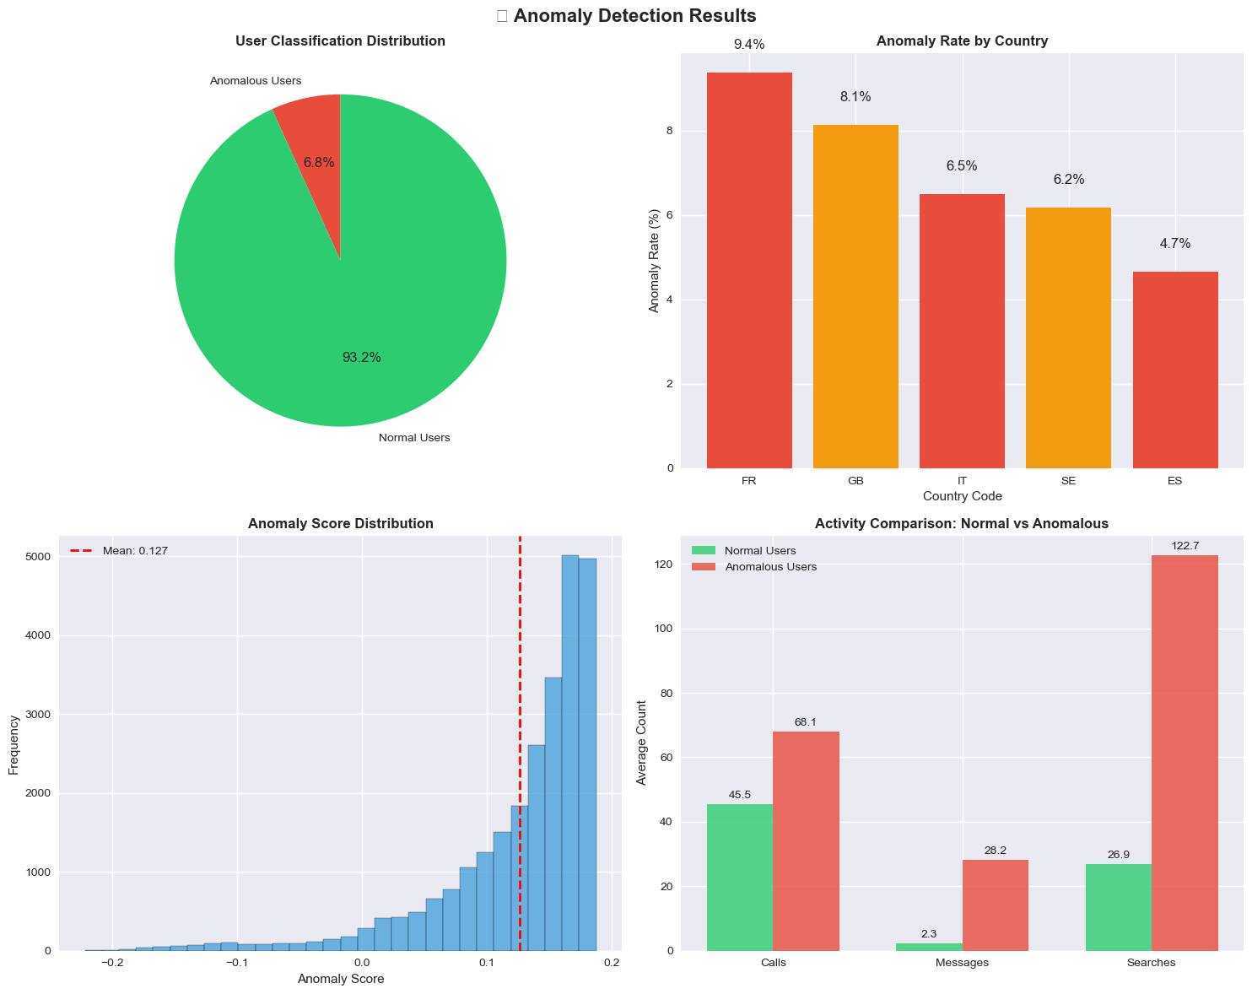
Overall Fraudulent User Insights
Anomaly Detection Results: 1,759 Users Show Suspicious Scraping Patterns
Comparative Analysis:
Normal Users (24,241): Avg Searches: 26.9 Avg Search-to-Comm Ratio: 1.72 Avg Activity Concentration: 10.26 Immediate Activity Rate: 95.4%
Anomalous Users (1,759): Avg Searches: 122.7 Avg Search-to-Comm Ratio: 32.25 Avg Activity Concentration: 39.08 Immediate Activity Rate: 67.2%
Key Differentiators: Anomalous users perform 4.6x more searches Search-to-comm ratio is 18.8x higher
Notes:
The anomaly detection process successfully classified 6.8% of users as anomalous, a plausible figure consistent with the problem's expected fraudulent user range.
These anomalous users, particularly in France and Great Britain where rates are higher, exhibit significantly more activity across the board, most notably performing nearly 4.5 times more searches than normal users (122.7 vs 26.9). This stark difference in search volume strongly validates their classification as data-harvesting scrapers.

Slide 12
NEXT STEPS & SCALING
From Detection to Protection: Scalable Implementation Roadmap
If given more time, what approaches would be promising?
Explore graph-based anomaly detection to capture relationships and collusion between users.
Use advanced deep learning models (e.g., Graph Neural Networks, Transformers) for richer behavioral modeling.
Incorporate sequence models to detect evolving fraud patterns over time.
Leverage semi-supervised or active learning to utilize limited labeled fraud data.
Integrate external signals (device, network, behavioral biometrics) for multi-modal fraud detection.
Develop explainable AI methods to provide actionable insights for business and compliance teams.
How does the approach scale if we have more than 100M users?
Isolation Forest and Autoencoder can be distributed using frameworks like Spark, Dask, or TensorFlow for large-scale data.
Feature engineering and model inference can be parallelized across clusters or cloud infrastructure.
For real-time detection, deploy models as microservices with horizontal scaling and use approximate nearest neighbor search for fast anomaly scoring.

